Slide 1
Model Driven Programmability
API Lesson with JSON
Jeff Sperley
Mt. Hood Community College
ISTM233P – Python for Cybersecurity

Slide 2
Welcome to the API Lesson with JSON

Slide 3

Python for Cybersecurity
This chapter of the course covers the following objectives:
Use Python to create programs that accept user input and read and write to external files.
Create a Python application that accesses an API based on user input and processes and displays the JSON data that is returned.

Slide 4
APIs and RESTful APIs

Slide 5

Application Programming Interface (API)
An API allows one piece of software talk to another.
An API is analogous to a power outlet.
Without a power outlet, what would you have to do to power your laptop?
Open the wall
Unsheath wires
Splice wires together
Understand all the wires in the wall
An API defines how a programmer can write a piece of software to extend an existing application’s features or even build entirely new applications.

Slide 6

API Example
Restaurant Recommendation App
Returns a list of relevant restaurants in the area
Integrates a third-party API to provide map functionality
The map API enforces a specification of an interface

Slide 7


Web Services Interface using HTTP
Web browsers use Hypertext Transfer Protocol (HTTP) to request (GET) a web page.
If successfully requested (HTTP status code 200), web servers respond to GET requests with a Hypertext Markup Language (HTML) coded web page.
Request
GET /index.htm HTTP/1.1
Send me the Cisco.com home page
Here’s the home page.
Client
Response
HTTP 200 OK <html>
Web Server

Slide 8
RESTful API using HTTP
Representation State Transfer (REST) APIs use HTTP to interface with RESTful services.
The HTTP request asks for JavaScript Object Notation (JSON) formatted data.
If successfully formatted according to the API documentation, the server will respond with JSON data.
Request
GET /json?address=san jose
Send me San Jose address info
Here’s the address info in JSON.
Client
Response
HTTP 200 OK {json data}
API Endpoint

Slide 9
RESTful API using HTTP
Representation State Transfer (REST) APIs use HTTP to interface with RESTful services.
The HTTP request asks for JavaScript Object Notation (JSON) formatted data.
If successfully formatted according to the API documentation, the server will respond with JSON data.
Request
GET /json?address=san jose
Send me San Jose address info
Here’s the address info in JSON.
Client
Response
HTTP 200 OK {json data}
API Endpoint

Slide 10
Anatomy of a RESTful Request
https://www.mapquestapi.com/directions/v2/route?outFormat=json&key=KEY&...
API Server
Resources
Format
Parameters
API Server: The URL for the server that answers REST requests
Resources: Specifies the API that is being requested.
Format: Usually JSON or XML
Parameters: Specifies what data is being requested

Slide 11
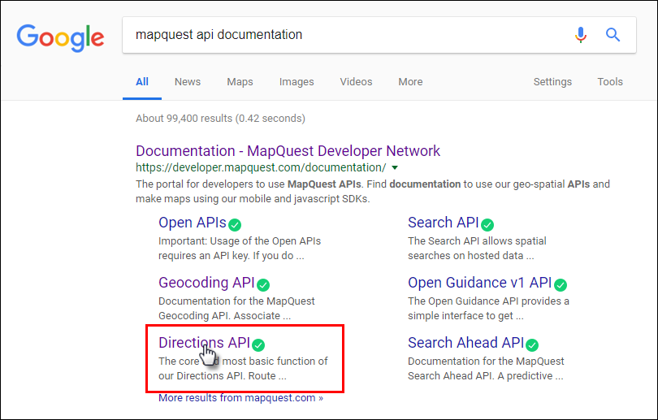
API Documentation
Use an Internet search to find documentation for an API.
Notes:
To successfully construct an API request, you must follow the API documentation. You can quickly find API documentation using an Internet search.

Slide 12
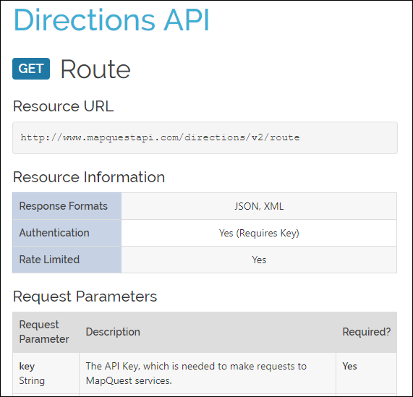
API Documentation
The API documentation will specify...
The request format (JSON, XML, or text)
The request parameters
The response fields

Slide 13
JSON and XML

Slide 14
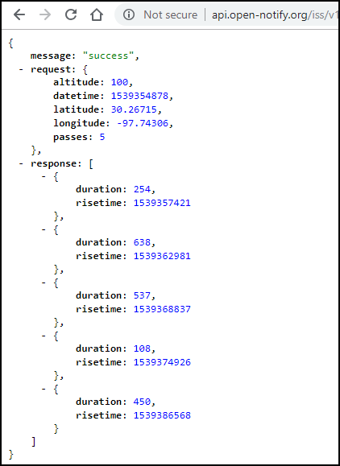
JSON Response Data
http://api.open-notify.org/iss/v1/?lat=30.26715&lon=-97.74306
Enter the above URL in your browser to get a JSON response.
JSON data looks a lot like a Python dictionary.
The third item in the dictionary is the response element.
Inside the list are five dictionaries.
Notes:
JavaScript Object Notation (JSON) is a format for storing and exchanging text between a server and a client application. It is easy to read and write. JSON is a very popular format that web services and APIs use to provide public data because it is easy to parse and can be used with most modern programming languages including Python.
In JSON, objects are indicated by curly braces and resemble Python dictionaries. JSON arrays are held in square brackets and resemble Python lists. To simplify the discussion, we will refer to the JSON structures using the familiar Python terms. Keep in mind however, that JSON data is usually converted to Python data structures before it is used by Python programs.

Slide 15
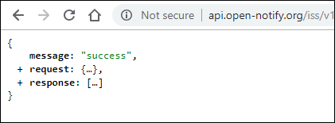
JSON Response Data
http://api.open-notify.org/iss/v1/?lat=30.26715&lon=-97.74306
Collapse components of the JSON to better view its structure.
In the example, JSON returns three root elements: message, request, and response
The message root returns the HTTP status code.
The request root shows default parameters and the parameters entered in the request.
The response root typically returns an array with relevant responses.

Slide 16
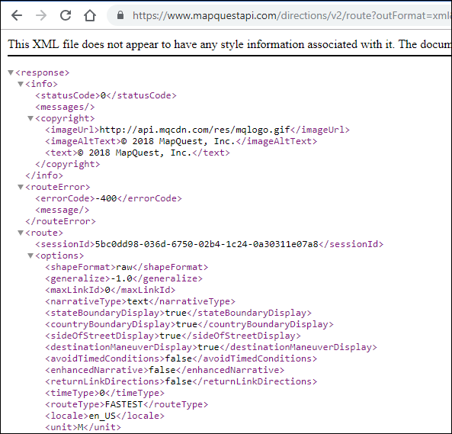
XML Response Data
https://www.mapquestapi.com/directions/v2/route?outFormat=xml&key=KEY...
Extensible Markup Language (XML) extends the functionality of HTML allowing web programmers to construct custom tags.
To get XML data instead of JSON from the MapQuest API, add the outFormat=xml to the URL structure.
You can see in the XML response that the embedded dictionaries have the same basic structure as JSON.

Slide 17
Parsing JSON with Python

Slide 18
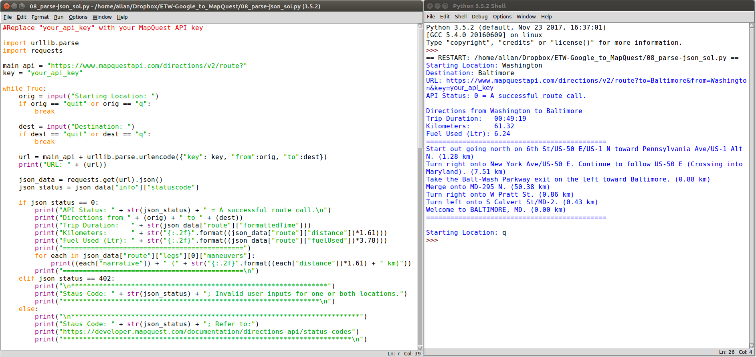
Demonstration - MapQuest API Application
Notes:
In this section, you will create an application that retrieves JSON data from the MapQuest Directions API, parses the data, and formats it for output to the user. The example shows output from a functioning version of the program. Notice that the user entered different values for a trip from Washington to Baltimore and then quit the program.

Slide 19
MapQuest API Application Objectives
To build this application, you will complete the following objectives:
Obtain a MapQuest API Key.
Import necessary modules.
Create API request variables and construct a URL.
Add user input functionality.
Add a quit feature so that the user can end the application.
Display trip information for time, distance, and fuel usage.
Iterate through the JSON data to extract and output the directions.
Display error messages for invalid user input.

Slide 20
Authenticating a RESTful Request
https://www.mapquestapi.com/directions/v2/route?key=your_api_key&to=Baltimore&...
API Server
Resources
Token
Parameters
None: The API resource is public and anybody can place the request.
Basic HTTP: The username and password are passed to the server in an encoded string.
Token: A secret key generally retrieved from the Web API developer portal.
Open Authorization (OAuth): An open standard for retrieving an access token from an Identity Provider. The token is then passed with each API call.
Notes:
Before building the application, you will need to obtain a key from MapQuest developer site, which you will do in the next step. Previously, you used no authentication to access the ISS Pass Predictions API. However, many APIs require some form of authentication.

Slide 21
Activity - Get Your MapQuest API Key
Go to: https://developer.mapquest.com/.
Click Sign Up at the top of the page.
Fill out the form to create a new account. For Company, enter Cisco Networking Academy Student.
After clicking Sign Me Up, you are redirected to the Manage Keys page.
Click Approve All Keys and expand My Application.
Copy your Consumer Key to Notepad for future use.
Notes:
Note: MapQuest may change the process for obtaining a key. If the steps above are no longer valid, search for “steps to generate mapquest api key”.

Slide 22
Importing Modules
Open a blank script file and save it as studentname_parse-json1.py.
Import modules
import urllib.parse import requests
Notes:
To begin our script for parsing JSON data, you will need to import two modules from the Python library: requests and urllib.parse. The request module provides functions for retrieving JSON data from a URL. The urllib.parse module provides a variety of functions that will enable us to parse and manipulate the JSON data you receive from a request to a URL.

Slide 23
Create Variables for API Request
Add the following variables to your script:
main_api - the main URL that you are accessing
orig - the parameter to specify your point of origin
dest - the parameter to specify your destination
key - the MapQuest API key you retrieved from the developer website
Combine the variables into the url variable using the urlencode method to properly format the address variable
main_api = "https://www.mapquestapi.com/directions/v2/route?"
orig = "Washington"
dest = "Baltimore"
key = "your_api_key"
url = main_api + urllib.parse.urlencode({"key": key, "from":orig, "to":dest})
Notes:
The first step in creating your API request is to construct the URL that your application will use to make the call. Initially, the URL will be the combination of the following variables main_api, orig, dest, and key. These variables are combined to create the url variable. The urlencode method is used so that the address value is properly formatted. For example, this method will convert space into “+” and a comma into “%2C.

Slide 24
Create the JSON Request
Create a variable that uses the get method to request JSON data from the submitted URL.
Print the results to verify the request was successful.
json_data = requests.get(url).json() print(json_data)
Notes:
Now you are ready to make the request by creating the json_data variable. The variable makes use of the get method of the requests module and specifies JSON as the requested format. The print statement is used to test that the request was successful.

Slide 25
Activity - Test the URL Request
========== RESTART: /home/user/studentname_parse-json1.py ==========
{'route': {'distance': 38.089, 'hasHighway': True, 'hasUnpaved': False, 'hasAccessRestriction': False, 'options': {'mustAvoidLinkIds': [], 'maxWalkingDistance': -1, 'manmaps': 'true', 'urbanAvoidFactor': -1, 'stateBoundaryDisplay': True, 'cyclingRoadFactor': 1, 'routeType': 'FASTEST', 'countryBoundaryDisplay': True, 'drivingStyle': 2, 'highwayEfficiency': 22, 'narrativeType': 'text', 'routeNumber': 0, 'tryAvoidLinkIds': [], 'generalize': -1, 'returnLinkDirections': False, 'doReverseGeocode': True, 'avoidTripIds': [], 'timeType': 0, 'sideOfStreetDisplay': True, 'filterZoneFactor': -1, 'walkingSpeed': -1, 'useTraffic': False, 'unit': 'M', 'tr
<output omitted>
>>>
Run your studentname_json-parse1.py script and verify it works.
Troubleshoot your code, if necessary.
You should get a similar JSON response to what is shown here.
Notes:
Optional: Change the orig and dest variable to get different results.

Slide 26
Print the URL and Check the Status of the JSON Request
Save your script as studentname_json-parse2.py.
Print the URL
Store the request status
Create an if loop that prints request status if statuscode is 0.
print("URL: " + (url))
json_data = requests.get(url).json()
json_status = json_data["info"]["statuscode"]
if json_status == 0:
print("API Status: " + str(json_status) + " = A successful route call.\n")
Notes:
Now that you know the JSON request is working, you can add some more functionality to the application by adding some print statements.

Slide 27
Activity - Test Status and URL Print Commands
========== RESTART: /home/user/studentname_parse-json2.py ==========
URL: https://www.mapquestapi.com/directions/v2/route?key=your_api_key&from=Washington&to=Baltimore
API Status: 0 = A successful route call.
>>>
Run your studentname_json-parse2.py script and verify it works.
Troubleshoot your code, if necessary.
You should get a similar output to what is shown here.

Slide 28
Add User Input for Address
Save your script as studentname_json-parse3.py.
Delete the current orig and dest variables.
Rewrite the orig and dest to be within a while loop in which it requests user input for the starting and destination location.
Be sure all the remaining code is indented within the while loop.
while True:
orig = input("Starting Location: ")
dest = input("Destination: ")
url = main_api + urllib.parse.urlencode({"key": key, "from":orig, "to":dest})
print("URL: " + (url))
Notes:
Up to this point, you have used Washington and Baltimore as static values for the location variables. However, our application requires that the user input the address value.

Slide 29
Activity - Test User Input
========== RESTART: /home/user/studentname_parse-json3.py ==========
Starting Location: Washington
Destination: Baltimore
URL: https://www.mapquestapi.com/directions/v2/route?key=your_api_key&from=Washington&to=Baltimore
API Status: 0 = A successful route call.
Starting Location: <Ctrl+C>
>>>
Run your studentname_json-parse3.py script and verify it works.
Troubleshoot your code, if necessary.
You should get a similar output to what is shown here.

Slide 30
Add Quit Functionality
Save your script as studentname_json-parse4.py.
Add an if statement after the address variable to check if the user enters q or quit.
while True:
orig = input("Starting Location: ")
if orig == "quit" or orig == "q":
break
dest = input("Destination: ")
if dest == "quit" or dest == "q":
break
Notes:
Instead of entering Ctrl+C to quit the program, you will add the ability for the user to enter q or quit as keywords to quit the program.

Slide 31
Activity - Test Quit Functionality
========== RESTART: /home/user/studentname_parse-json4.py ==========
Starting Location: q
>>>
========== RESTART: /home/user/studentname_parse-json4.py ==========
Starting Location: quit
>>>
========== RESTART: /home/user/studentname_parse-json4.py ==========
Starting Location: Washington
Destination: q
>>>
========== RESTART: /home/user/studentname_parse-json4.py ==========
Starting Location: Washington
Destination: quit
>>>
Run your studentname_json-parse4.py script and verify it works.
Troubleshoot your code, if necessary.
You should get a similar output to what is shown here.

Slide 32
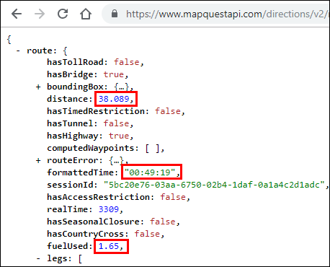
Displaying Trip Data
The final application prints the values for the distance, formattedTime, and fuelUsed keys from the route dictionary.
Starting Location: Washington
Destination: Baltimore
URL: https://www.mapquestapi.com/directions/v2/route?to=Baltimore&key=Your_api_key&from=Washington
API Status: 0
Directions from Washington to Baltimore
Trip Duration: 00:49:19
Miles: 38.089
Fuel Used (Gal): 1.65
=============================================
Starting Location: q
>>>
Notes:
Copy your URL into your web browser. If you collapse all of the JSON data, you will see that there are two root dictionaries: route and info.
Expand the route dictionary and investigate the rich data. There are values to indicate whether the route has toll roads, bridges, tunnels, highways, closures, or crosses into other countries. You should also see values for distance, the total time the trip will take, and fuel usage, as highlighted below. To parse and display this, you will specify the route dictionary and select key/value pair you want to print.

Slide 33
Parse and Display Trip Data
Save your script as studentname_json-parse5.py.
Below the API status print command, add print statements that display the from and to locations, as well as the formattedTime, distance, and fuelUsed keys.
Add a print statement that will display a double line before the next request for a starting location as shown below.
if json_status == 0:
print("API Status: " + str(json_status) + " = A successful route call.\n")
print("Directions from " + (orig) + " to " + (dest))
print("Trip Duration: " + str(json_data["route"]["formattedTime"]))
print("Miles: " + str(json_data["route"]["distance"]))
print("Fuel(Gal): " + str(json_data["route"]["fuelUsed"]))
print("=============================================")

Slide 34
Activity - Test Trip Data Display
========== RESTART: /home/user/studentname_parse-json5.py ==========
Starting Location: Washington
Destination: Baltimore
URL: https://www.mapquestapi.com/directions/v2/route?to=Baltimore&key=Your_api_key&from=Washington
API Status: 0 = A successful route call.
Directions from Washington to Baltimore
Trip Duration: 00:49:19
Miles: 38.089
Fuel Used (Gal): 1.65
=============================================
Starting Location: q
>>>
Run your studentname_json-parse5.py script and verify it works.
Troubleshoot your code, if necessary.
You should get a similar output to what is shown here.

Slide 35
Convert Imperial to Metric
Convert the distance and fuelUsed values to the metric system.
print("Kilometers: " + str((json_data["route"]["distance"])*1.61))
print("Fuel Used (Ltr): " + str((json_data["route"]["fuelUsed"])*3.78))

Slide 36
Activity - Test Metric Conversion
========== RESTART: /home/user/studentname_parse-json5.py ==========
Starting Location: Washington
Destination: Baltimore
URL: https://www.mapquestapi.com/directions/v2/route?to=Baltimore&key=Your_api_key&from=Washington
API Status: 0 = A successful route call.
Directions from Washington to Baltimore
Trip Duration: 00:49:19
Kilometers: 61.32329
Fuel Used (Ltr): 6.236999999999999
=============================================
Starting Location: q
>>>
Run your studentname_json-parse5.py script and verify it works.
Troubleshoot your code, if necessary.
You should get a similar output to what is shown here.

Slide 37
Format to 2 Decimal Places
Use the "{:.2f}".format argument to format the float values to 2 decimal places before converting them to string values, as shown below.
Each statement should be on one line.
print("Kilometers: " + str("{:.2f}".format((json_data["route"]["distance"])*1.61)))
print("Fuel Used (Ltr): " + str("{:.2f}".format((json_data["route"]["fuelUsed"])*3.78)))

Slide 38
Activity - Test Formatting Decimal Places
========== RESTART: /home/user/studentname_parse-json5.py ==========
Starting Location: Washington
Destination: Baltimore
URL: https://www.mapquestapi.com/directions/v2/route?key=your_api_key&to=Baltimore&from=Washington
API Status: 0 = A successful route call.
Directions from Washington to Baltimore
Trip Duration: 00:49:19
Kilometers: 61.32
Fuel Used (Ltr): 6.24
=============================================
Starting Location: q
>>>
Run your studentname_json-parse5.py script and verify it works.
Troubleshoot your code, if necessary.
You should get a similar output to what is shown here.

Slide 39
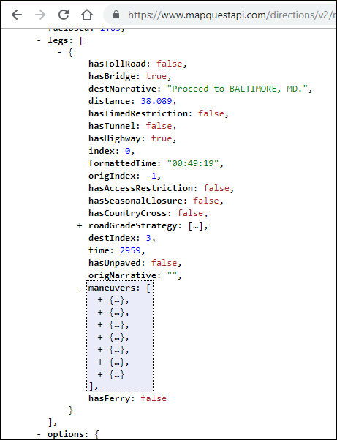
Inspect the Directions JSON Data
Locate the legs list inside the route dictionary.
The legs list includes one big dictionary with most of the JSON data.
Find the maneuvers list and collapse each of the seven dictionaries inside.

Slide 40
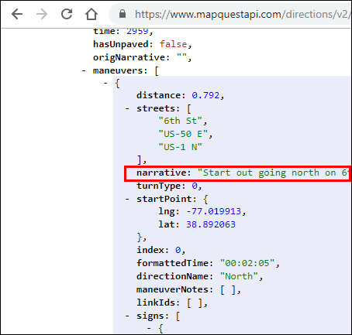
Inspect the Maneuvers JSON Data
Expand the first dictionary in the maneuvers list. Each dictionary contains a narrative key with a value, such as “Start out going north...”
You will parse the JSON data to extract the values for narrative and distance keys to display inside your application.

Slide 41
Iterate Through the Directions Data
Save your script as studentname_json-parse6.py.
Add an if statement below the double line print statement to check the json_status.
The for loop iterates through each maneuvers list, prints the narrative, and prints the distance in kilometers formatting for 2 decimal places.
Add a print statement that will display a double line at the end of the list of maneuvers.
print("=============================================")
for each in json_data["route"]["legs"][0]["maneuvers"]:
print((each["narrative"]) + " (" + str("{:.2f}".format((each["distance"])*1.61) + " km)"))
print("=============================================\n")
Notes:
The for loop iterates through each maneuvers list and does the following:
1) Prints the narrative value.
2) Converts miles to kilometers with *1.61.
3) Formats the kilometer value to print only two decimal places with the "{:.2f}".format function.
Note: The print statement must be on one line.

Slide 42
Activity - Test Iteration
========= RESTART: /home/user/studentname_parse-json6.py ==========
Starting Location: Washington
Destination: Baltimore
URL: https://www.mapquestapi.com/directions/v2/route?key=Your_api_key&to=Baltimore&from=Washington
API Status: 0 = A successful route call.
Directions from Washington to Baltimore
Trip Duration: 00:49:19
Kilometers: 61.32
Fuel Used (Ltr): 6.24
=============================================
Start out going north on 6th St/US-50 E/US-1 N toward Pennsylvania Ave/US-1 Alt N. (1.28 km)
Turn right onto New York Ave/US-50 E. Continue to follow US-50 E (Crossing into Maryland). (7.51 km)
Take the Balt-Wash Parkway exit on the left toward Baltimore. (0.88 km)
Merge onto MD-295 N. (50.38 km)
Turn right onto W Pratt St. (0.86 km)
Turn left onto S Calvert St/MD-2. (0.43 km)
Welcome to BALTIMORE, MD. (0.00 km)
=============================================
Starting Location: q
>>>
Run your studentname_json-parse6.py script and verify it works.
Troubleshoot your code, if necessary.
You should get a similar output to what is shown here.

Slide 43
Check for Invalid User Input
Save your script as studentname_json-parse7.py.
The final step is to finish the if loop to respond to the user when the json_status does not equal 0.
The most common error will most likely be for invalid location entries.
Create a elif function that checks for json_status = 402 and display a message, as shown here.
if json_status == 0:
.
.
.
elif json_status == 402:
print("**********************************************")
print("For Staus Code: " + str(json_status) + "; Invalid user inputs for one or both locations.")
print("**********************************************\n")
print("=============================================")
Notes:
Now you are ready to add one final feature to your application to report an error when the user enters invalid data. Recall that you started an if loop to make sure the returned statuscode equals 0 before parsing the JSON data.
But what happens if the statuscode is not equal to 0? For example, the user might enter an invalid location or might not enter one or more locations. If so, then the application displays the URL and asks for a new starting location. The user has no idea what happened. Try the following values in your application.
Washington and Beijing
Washington and Balt
Washington and <no entry>
What results do you get?
The if loop does not yet have a contingency for when the statuscode is not equal to 0. So the while loop starts over and the user is presented with the Starting Location input query.

Slide 44
Check for Other Error Types
Invalid user inputs is only one error type.
You could write code to display error messages for other common errors.
For this application, add an else statement that ends the if loop and covers all other json_status values, as shown here.
elif json_status == 402:
print("**********************************************")
print("For Staus Code: " + str(json_status) + "; Invalid user inputs for one or both locations.")
print("**********************************************\n")
print("=============================================")
else:
print("************************************************************************")
print("For Staus Code: " + str(json_status) + ", Refer to:")
print("https://developer.mapquest.com/documentation/directions-api/status-codes")
print("************************************************************************\n")
Notes:
The elif statement prints if the statuscode value is 402 for an invalid location. The else statement prints for all other statuscode values, such as no entry for one or more locations. The else statement ends the if/else loop and returns the application to the while loop.

Slide 45
Activity - Test Full Application Functionality
Run your studentname_json-parse7.py script and verify it works.
Troubleshoot your code, if necessary.
For errors, you should get a similar output as shown on the next slide.

Slide 46
!
========= RESTART: /home/user/studentname_parse-json7.py ==========
Starting Location: Washington
Destination: Beijing
URL: https://www.mapquestapi.com/directions/v2/route?key=your_api_key&from=WashingtonTurn+right+onto+%E5%89%8D%E9%97%A8%E8%A5%BF%E5%A4%A7%E8%A1%97%2FQianmen+West+Street.+%281.01+km%29&to=Beijing
****************************************************************
Status Code: 402; Invalid user inputs for one or both locations.
****************************************************************
Starting Location: Washington
Destination: Balt
URL: https://www.mapquestapi.com/directions/v2/route?key=your_api_key&from=Washington&to=Balt
************************************************************************
Status Code: 602; Refer to:
https://developer.mapquest.com/documentation/directions-api/status-codes
************************************************************************
Starting Location: Washington
Destination: [no user input]
URL: https://www.mapquestapi.com/directions/v2/route?key=your_api_key&from=Washington&to=
************************************************************************
Status Code: 611; Refer to:
https://developer.mapquest.com/documentation/directions-api/status-codes
************************************************************************

